Slide 1
IBM University Engagement Project Submission
“Exploring the Power of Agentic AI with IBM Granite ”

Slide 2

Project Tile – Street Vendor Digitalization Agent
Domain of Project – Education
Student Name | Recent Passport Photo | Email ID | Mobile number [WhatsApp]
Aditya Pattnaik |  | adityapattnaik393@gmail.com | 9112628271

Slide 3
Problem Statement :
Problem Statement : Street Vendor Digitalization Agent
The Challenge:
A Street Vendor Digitalization Agent, powered by RAG (Retrieval-Augmented Generation), helps local hawkers and micro-entrepreneurs become digitally visible by generating business profiles, UPI setup guides, local SEO strategies, and customer engagement tips.
It retrieves real-time policies, MSME schemes, geolocation of business data, digital onboarding steps, and consumer behaviour insights from government portals, fintech apps, and commerce platforms.
Vendors can simply say, “I sell fruit in Pune’s Camp area,” and the agent will suggest pricing tips, online listing platforms, QR code setup, and promotional materials in their local language. This AI-driven assistant empowers informal businesses to grow digitally, unlock access to credit, and boost visibility in the hyperlocal economy.

Slide 4
Proposed Solution:
Proposed Solution: AI-Powered Street Vendor Digitalization Agent
The proposed solution is a bilingual, agentic AI assistant built using IBM watsonx.ai, IBM Granite Models, ChromaDB and FastAPI to help Indian street vendors adopt digital tools, find government schemes and grow their business. The system addresses challenges such as low digital literacy, difficulty finding scheme details, limited online presence and language barriers, through a simple chat interface in English and Hindi.
At its core, the solution uses a Retrieval-Augmented Generation (RAG) pipeline to fetch accurate information from trusted sources such as the PM SVANidhi guidelines, street vendor policy documents, BHIM UPI guidelines, ONDC frameworks and etc. These documents are converted to Markdown, split into chunks, embedded with a multilingual model and stored in a vector database. This lets the system retrieve the most relevant passages and have Granite compose a grounded, easy-to-follow answer. To keep answers current, the system adds live verification. When a vendor asks about schemes, eligibility, amounts or deadlines, Granite decides whether current information is needed. If it is, the system searches only allowlisted official government websites and returns the answer with clickable official links and retrieval dates. If verification fails, the system falls back to stored documents and tells the vendor so.
Overall, this solution delivers an end-to-end intelligent digitalization assistant that helps street vendors access government support, build an online presence and adopt digital payments through trustworthy, multilingual and verifiable guidance.

Slide 5
Technology Used:
IBM Granite model (granite-4-h-small): for natural language understanding, bilingual (English/Hindi) answer generation, and deciding when live verification is needed.
IBM watsonx.ai: for model access through the chat API, project-level configuration, and AI governance.
IBM Cloud (Lite) and IBM IAM: for secure API-key authentication and a reliable, scalable cloud environment.
RAG (Retrieval-Augmented Generation): fetches trusted data first, then generates grounded answers, making VendorMitra more trustworthy and accurate.
ChromaDB (vector database): persistent storage for document embeddings, retrieving the top 3 relevant passages.
LangChain text splitters: for chunking documents before indexing.
Docling : for converting source PDFs to Markdown for ingestion
Tavily Search API: for live search restricted to official government websites.
FastAPI and Uvicorn : backend API serving the chat interface.
HTML/JavaScript chat UI with browser local Storage: bilingual interface with profile editor and saved chat history.

Slide 6
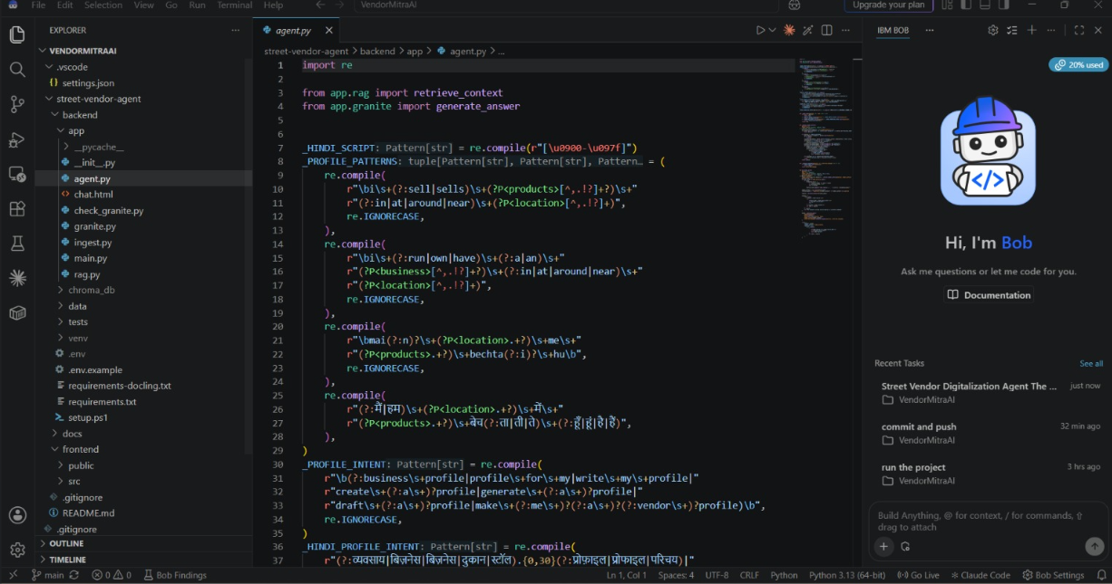
IBM BOB:

Slide 7
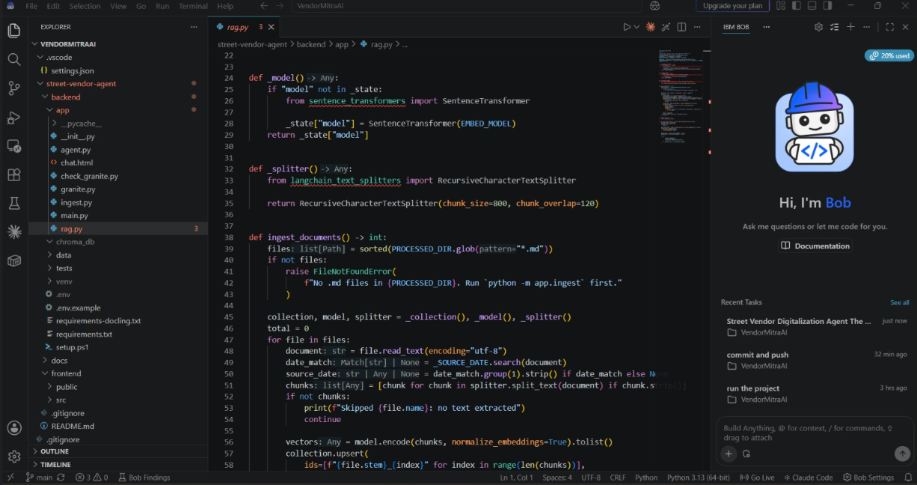

Slide 8
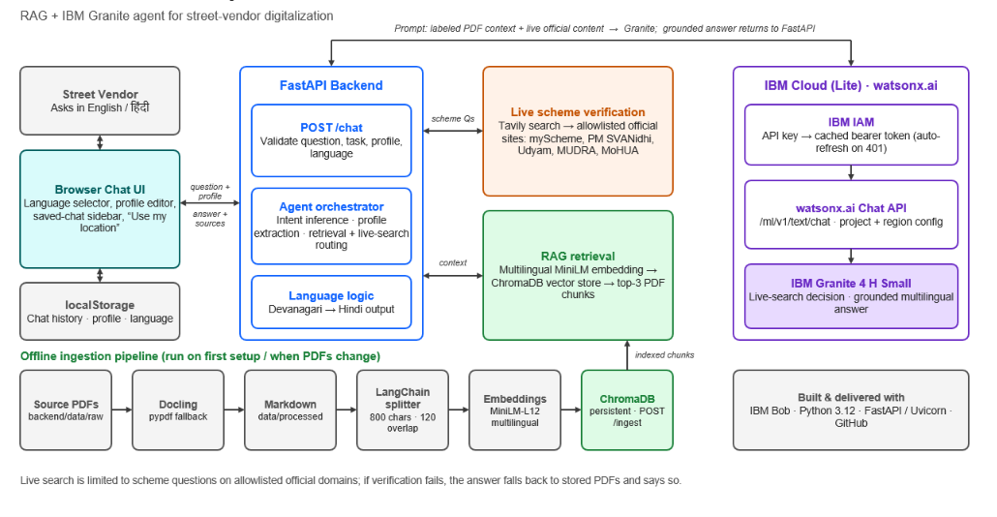
Architecture blueprint:

Slide 9

Role of Agentic AI in the solution:
Role of Agentic AI in VendorMitra
VendorMitra uses agentic AI to go beyond a simple chatbot. Instead of answering only from stored documents, the agent reasons, decides and acts on each vendor’s question. IBM Granite first interprets the request and decides whether it needs current information. For government-scheme questions about eligibility, amounts or deadlines, the agent autonomously triggers a live search of official government websites (myScheme, PM SVANidhi, Udyam, MUDRA, MoHUA) and combines the results with its stored knowledge base. It also infers the task, such as writing a business profile or promotional material, extracts vendor details from the conversation, and responds in the vendor’s language. If a live search fails, it adapts by falling back to stored documents and tells the vendor so. This turns a static Q&A system into a proactive, tool-using assistant that delivers accurate, verifiable and personalized guidance.

Slide 10
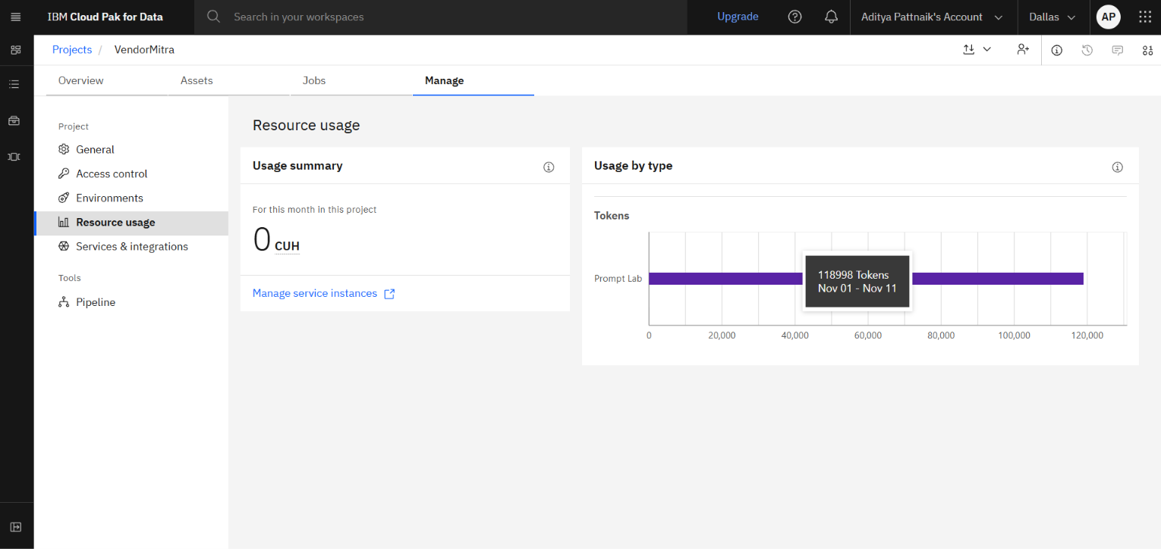
TOKEN USAGE:

Slide 11
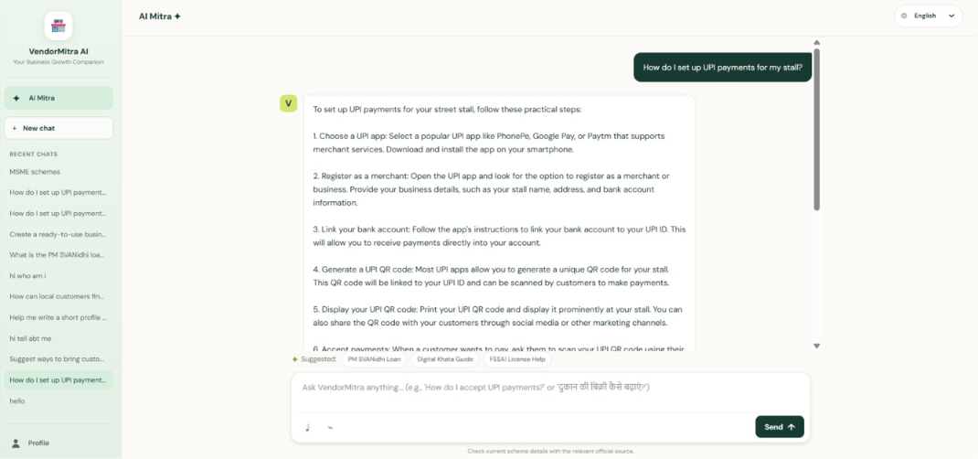
Project Photos:
·
·
·

Slide 12
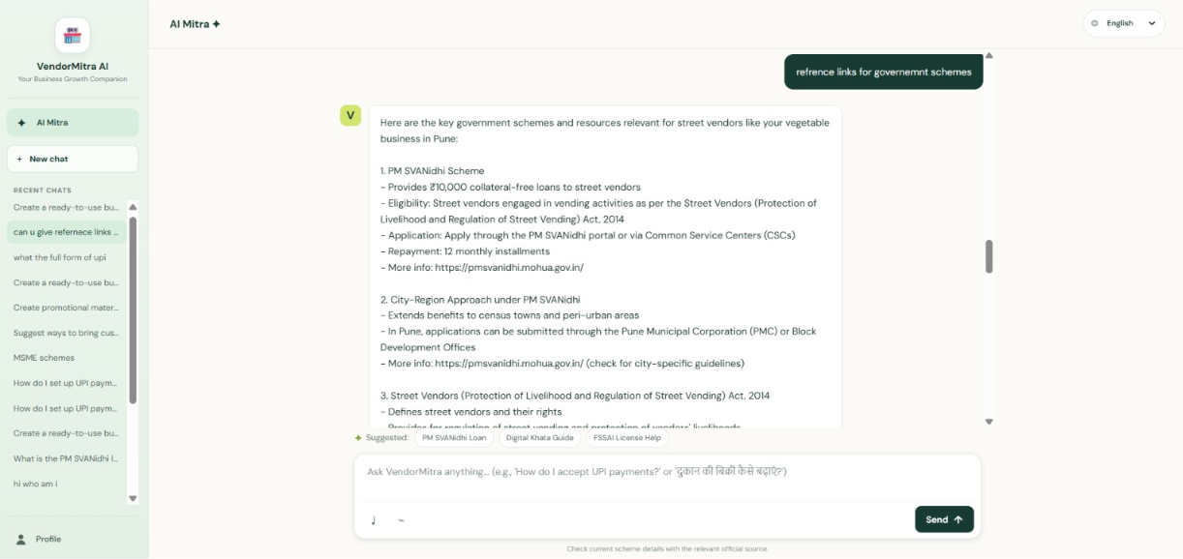

Slide 13
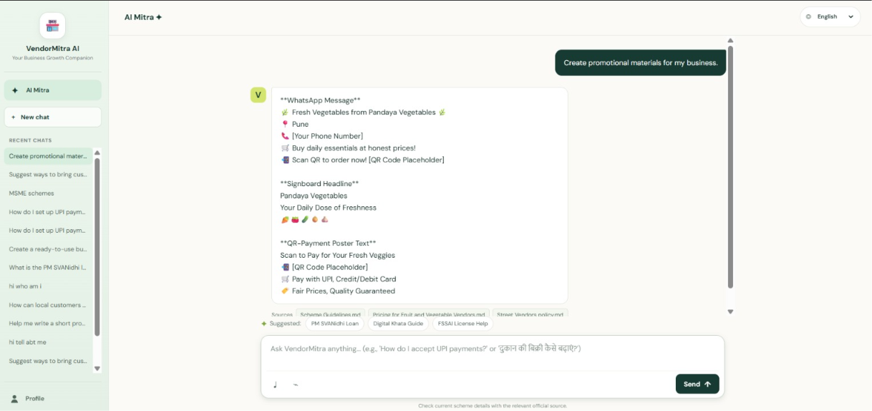

Slide 14
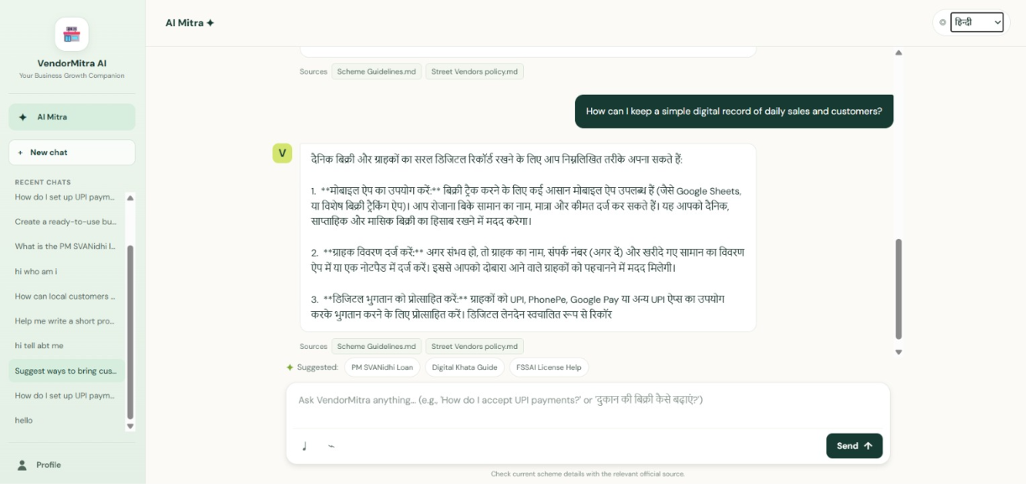

Slide 15
Novelty and Uniqueness:
Agent-decided live verification: most RAG chatbots answer only from stored documents. VendorMitra’s Granite model decides when a scheme question needs current information, then searches official government websites on its own.
Trusted-source allowlist: live search is restricted to official domains (myScheme, PM SVANidhi, Udyam, MUDRA, MoHUA), and anything from other sites is discarded. This reduces misinformation, which is a serious risk when people ask about money and benefits.
Transparent sourcing: stored-document information is labeled separately from live website information, and answers carry clickable official links with retrieval and verification dates. Dated data, such as the 2024 PM SVANidhi dataset, is never presented as real-time.
Built for vendors, not generic users: it combines scheme guidance with practical digital tools in one chat. These include business profiles, WhatsApp messages, signboard and QR-poster copy, UPI setup and local-listing advice.
Bilingual and inclusive: it detects Hindi (Devanagari) automatically and replies in the vendor’s language. Vendors can describe their stall in plain words, and the agent extracts their products and location to personalize answers.
Graceful failure: if live search is unavailable, it falls back to stored documents and tells the vendor, rather than guessing.
Safe and private by design: it never invents URLs, prices or scheme rules, and treats retrieved text as data, not instructions. Chat history and profile stay in the vendor’s browser, and location is not sent to external services.

Slide 16
Git Hub Link:
https://github.com/adityapattnaik393-glitch/VendorMitra-AI
Project Deployed Link:
https://vendormitra-ai.onrender.com

Slide 17
Future Scope:
More regional languages: add Marathi, Tamil, Bengali and other languages, with both voice input and spoken answers (Hindi and English already work), so low-literacy vendors can use it in their own language.
WhatsApp delivery: make VendorMitra available on WhatsApp, including voice notes, where vendors already are.
Production hardening: rate limiting, protected admin endpoints and usage monitoring for a public rollout.
Digital commerce integration: connect with UPI and ONDC so vendors can set up QR payments and list their stalls online.
Answer quality and trust: use watsonx.governance to monitor answer quality and safety, backed by a tested set of English and Hindi questions with expected sources.
·

Slide 18
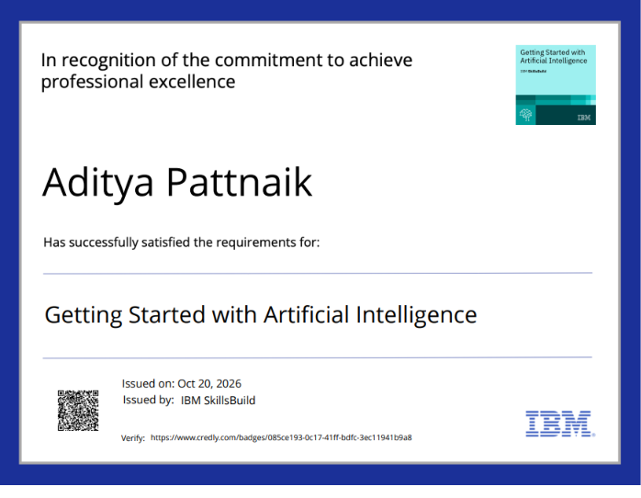
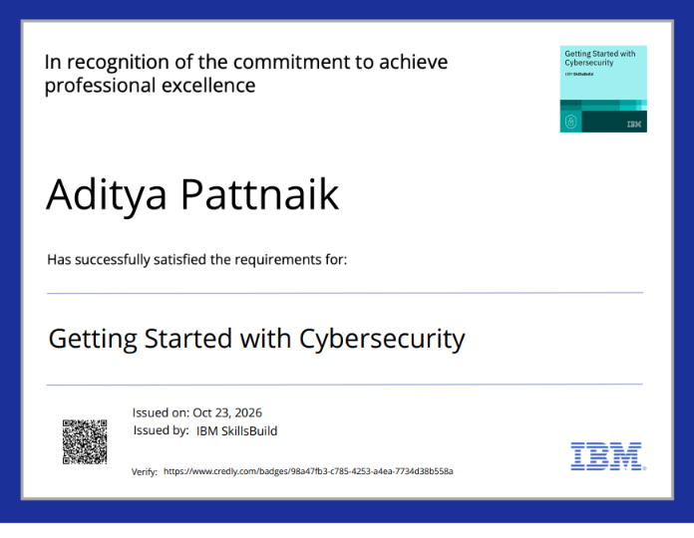
Certificates Earned:

Slide 19
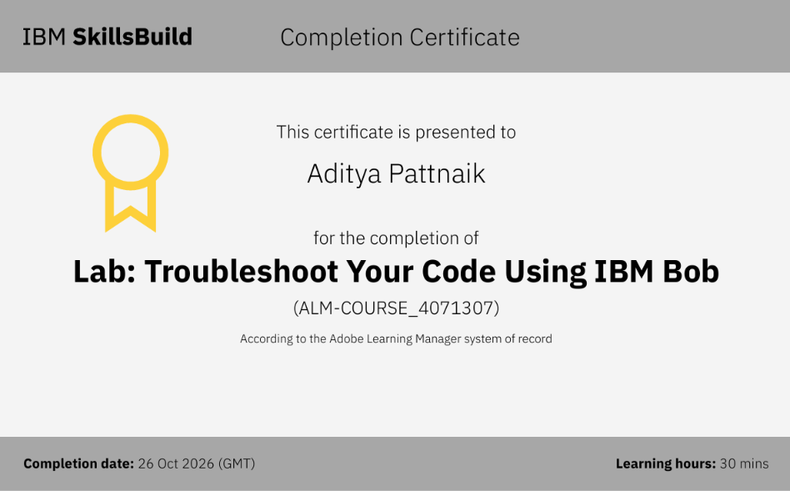
IBM BOB Certificate:​

Slide 20


